Slide 1
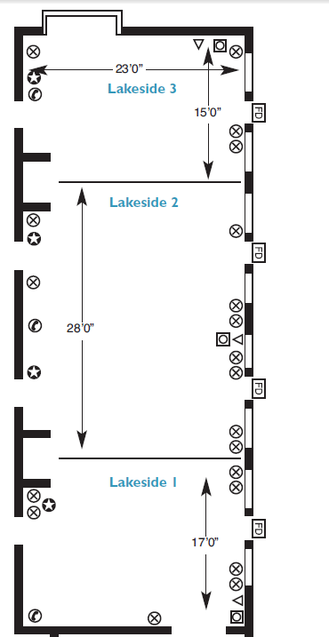
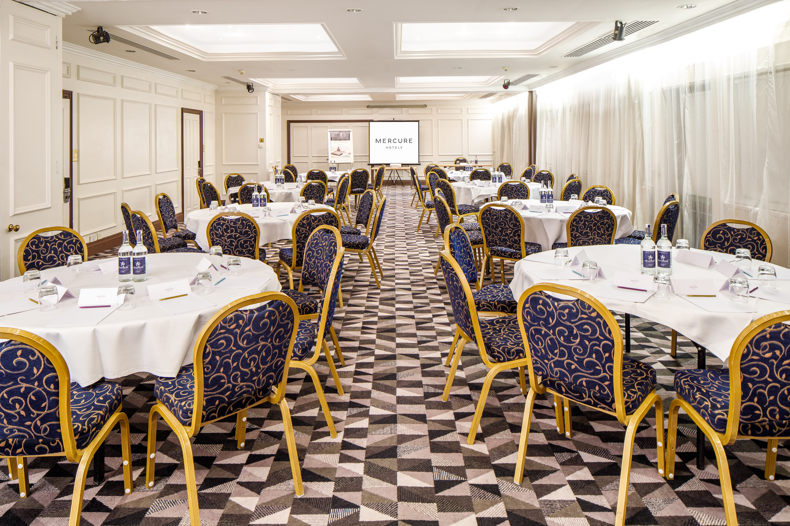

LAKESIDE SUITE
The Lakeside Suite can be split into three rooms. Located on the ground floor, the Lakeside Suite is accessible to all.
Key Information
Floor | Ground
Disabled access | Yes
Natural Daylight | Yes
Air Conditioning | No
Setup | Capacity
Theatre | 140
Cabaret | 80
Boardroom | 60
Classroom | 60
U-shape | 40
Dinner | 100
Room Dimensions
Height | 2.47m
Length & Width | 18.30m x 7.03m
Square Metres | 128.65

